Slide 1
Information Security Fall 2023

Slide 2
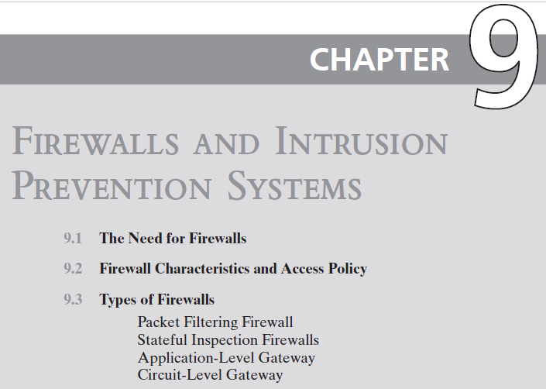
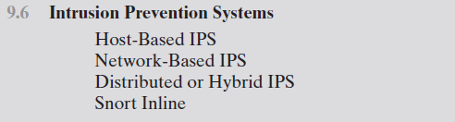

Slide 3
The Need For Firewalls
Internet connectivity is essential
However it creates a threat
Effective means of protecting LANs
Inserted between the premises network and the Internet to establish a controlled link
Can be a single computer system or a set of two or more systems working together
Used as a perimeter defense
Single choke point to impose security and auditing
Insulates the internal systems from external networks
Notes:
Internet connectivity is no longer optional for organizations. The information
and services available are essential to the organization. Moreover, individual users
within the organization want and need Internet access, and if this is not provided
via their LAN, they could use a wireless broadband capability from their PC to an
Internet service provider (ISP). However, while Internet access provides benefits to
the organization, it enables the outside world to reach and interact with local network
assets. This creates a threat to the organization. While it is possible to equip
each workstation and server on the premises network with strong security features,
such as intrusion protection, this may not be sufficient and in some cases is not cost effective.
Consider a network with hundreds or even thousands of systems, running
various operating systems, such as different versions of Windows, MacOS, and
Linux. When a security flaw is discovered, each potentially affected system must be
upgraded to fix that flaw. This requires scaleable configuration management and
aggressive patching to function effectively. While difficult, this is possible and is necessary
if only host-based security is used. A widely accepted alternative or at least
complement to host-based security services is the firewall. The firewall is inserted
between the premises network and the Internet to establish a controlled link and to
erect an outer security wall or perimeter. The aim of this perimeter is to protect the
premises network from Internet-based attacks and to provide a single choke point
where security and auditing can be imposed. The firewall may be a single computer
system or a set of two or more systems that cooperate to perform the firewall function.
The firewall, then, provides an additional layer of defense, insulating the internal
systems from external networks. This follows the classic military doctrine of
“defense in depth,” which is just as applicable to IT security.

Slide 4
Firewall Characteristics
Design goals
All traffic from inside to outside, and vice versa, must pass through the firewall
Only authorized traffic as defined by the local security policy will be allowed to pass
The firewall itself is immune to penetration
Notes:
[BELL94] lists the following design goals for a firewall:
1. All traffic from inside to outside, and vice versa, must pass through the firewall.
This is achieved by physically blocking all access to the local network except via
the firewall. Various configurations are possible, as explained later in this chapter.
2. Only authorized traffic, as defined by the local security policy, will be allowed
to pass. Various types of firewalls are used, which implement various types of
security policies, as explained later in this chapter.
3. The firewall itself is immune to penetration. This implies the use of a hardened
system with a secured operating system, as we will describe in Chapter 12.

Slide 5
Firewall Access Policy
A critical component in the planning and implementation of a firewall is specifying a suitable access policy
This lists the types of traffic authorized to pass through the firewall
Includes address ranges, protocols, applications and content types
This policy should be developed from the organization’s information security risk assessment and policy
Should be developed from a broad specification of which traffic types the organization needs to support
Then refined to detail the filter elements which can then be implemented within an appropriate firewall topology
Notes:
A critical component in the planning and implementation of a firewall is
specifying a suitable access policy. This lists the types of traffic authorized to pass
through the firewall, including address ranges, protocols, applications and content
types. This policy should be developed from the organization’s information security
risk assessment and policy, that we discuss in Chapters 14 and 15. This policy
should be developed from a broad specification of which traffic types the organization
needs to support. It is then refined to detail the filter elements we discuss next,
which can then be implemented within an appropriate firewall topology.

Slide 6
Firewall Filter Characteristics
Characteristics that a firewall access policy could use to filter traffic include:
IP address and protocol values
This type of filtering is used by packet filter and stateful inspection firewalls
Typically used to limit access to specific services
Application protocol
This type of filtering is used by an application-level gateway that relays and monitors the exchange of information for specific application protocols
User identity
Typically for inside users who identify themselves using some form of secure authentication technology
Network activity
Controls access based on considerations such as the time or request, rate of requests, or other activity patterns
Notes:
NIST SP 800-41 (Guidelines on Firewalls and Firewall Policy, September 2009)
lists a range of characteristics that a firewall access policy could use to filter traffic,
including:
• IP Address and Protocol Values: Controls access based on the source or
destination addresses and port numbers, direction of flow being inbound or
outbound, and other network and transport layer characteristics. This type of
filtering is used by packet filter and stateful inspection firewalls. It is typically
used to limit access to specific services.
• Application Protocol: Controls access on the basis of authorized application
protocol data. This type of filtering is used by an application-level gateway
that relays and monitors the exchange of information for specific application
protocols, for example, checking Simple Mail Transfer Protocol (SMTP) e-mail for spam, or HTPP Web requests to
authorized sites only.
• User Identity: Controls access based on the users identity, typically for inside
users who identify themselves using some form of secure authentication technology,
such as IPSec (Chapter 22).
• Network Activity: Controls access based on considerations such as the time or
request, for example, only in business hours; rate of requests, for example, to detect scanning
attempts; or other activity patterns.

Slide 7
Firewall Capabilities And Limits
Capabilities:
Defines a single choke point
Provides a location for monitoring security events
Convenient platform for several Internet functions that are not security related
Can serve as the platform for IPSec
Limitations:
Cannot protect against attacks bypassing firewall
May not protect fully against internal threats
Improperly secured wireless LAN can be accessed from outside the organization
Laptop, PDA, or portable storage device may be infected outside the corporate network then used internally
Notes:
Before proceeding to the details of firewall types and configurations, it is best
to summarize what one can expect from a firewall. The following capabilities are
within the scope of a firewall:
1. A firewall defines a single choke point that attempts to keep unauthorized
users out of the protected network, prohibit potentially vulnerable services
from entering or leaving the network, and provide protection from various
kinds of IP spoofing and routing attacks. The use of a single choke point
simplifies security management because security capabilities are consolidated
on a single system or set of systems.
2. A firewall provides a location for monitoring security-related events. Audits
and alarms can be implemented on the firewall system.
3. A firewall is a convenient platform for several Internet functions that are not
security related. These include a network address translator, which maps local
addresses to Internet addresses, and a network management function that
audits or logs Internet usage.
4. A firewall can serve as the platform for IPSec. Using the tunnel mode capability
described in Chapter 22 , the firewall can be used to implement virtual
private networks.
Firewalls have their limitations, including the following:
1. The firewall cannot protect against attacks that bypass the firewall. Internal
systems may have dial-out or mobile broadband capability to connect to
an ISP. An internal LAN may support a modem pool that provides dial-in
capability for traveling employees and telecommuters.
2. The firewall may not protect fully against internal threats, such as a disgruntled
employee or an employee who unwittingly cooperates with an external
attacker.
3. An improperly secured wireless LAN may be accessed from outside the
organization. An internal firewall that separates portions of an enterprise
network cannot guard against wireless communications between local systems
on different sides of the internal firewall.
4. A laptop, PDA, or portable storage device may be used and infected outside
the corporate network and then attached and used internally.

Slide 8
Notes:
A firewall can monitor network traffic at a number of levels, from low-level network
packets, either individually or as part of a flow, to all traffic within a transport connection,
up to inspecting details of application protocols. The choice of which level
is appropriate is determined by the desired firewall access policy. It can operate as a
positive filter, allowing to pass only packets that meet specific criteria, or as a negative
filter, rejecting any packet that meets certain criteria. The criteria implement the
access policy for the firewall that we discussed in the previous section. Depending
on the type of firewall, it may examine one or more protocol headers in each packet,
the payload of each packet, or the pattern generated by a sequence of packets. In this
section, we look at the principal types of firewalls.

Slide 9
Packet Filtering Firewall
Applies rules to each incoming and outgoing IP packet
Typically a list of rules based on matches in the IP or TCP header
Forwards or discards the packet based on rules match
Two default policies:
Discard - prohibit unless expressly permitted
More conservative, controlled, visible to users
Forward - permit unless expressly prohibited
Easier to manage and use but less secure
Filtering rules are based on information contained in a network packet
Source IP address
Destination IP address
Source and destination transport-level address
IP protocol field
Interface
Notes:
A packet filtering firewall applies a set of rules to each incoming and outgoing
IP packet and then forwards or discards the packet ( Figure 9.1b ). The firewall
is typically configured to filter packets going in both directions (from and to
the internal network). Filtering rules are based on information contained in a
network packet:
• Source IP address: The IP address of the system that originated the IP packet
(e.g., 192.178.1.1)
• Destination IP address: The IP address of the system the IP packet is trying to
reach (e.g., 192.168.1.2)
• Source and destination transport-level address: The transport-level (e.g., TCP
or UDP) port number, which defines applications such as SNMP or HTTP.
• IP protocol field: Defines the transport protocol
• Interface: For a firewall with three or more ports, which interface of the firewall
the packet came from or for which interface of the firewall the packet is destined.
The packet filter is typically set up as a list of rules based on matches to fields
in the IP or TCP header. If there is a match to one of the rules, that rule is invoked
to determine whether to forward or discard the packet. If there is no match to any
rule, then a default action is taken. Two default policies are possible:
• Default = discard: That which is not expressly permitted is prohibited.
• Default = forward: That which is not expressly prohibited is permitted.
The default discard policy is more conservative. Initially, everything is blocked,
and services must be added on a case-by-case basis. This policy is more visible to
users, who are more likely to see the firewall as a hindrance. However, this is the
policy likely to be preferred by businesses and government organizations. Further,
visibility to users diminishes as rules are created. The default forward policy increases
ease of use for end users but provides reduced security; the security administrator
must, in essence, react to each new security threat as it becomes known. This policy
may be used by generally more open organizations, such as universities.

Slide 10
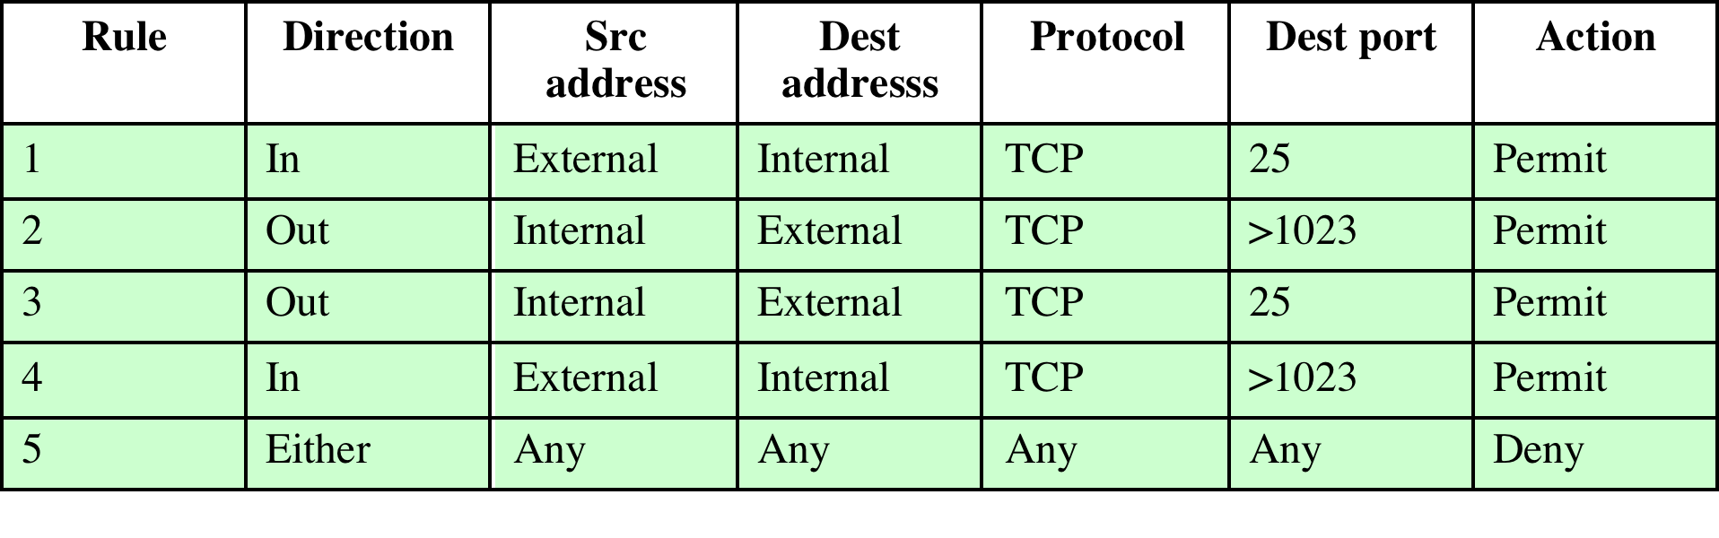
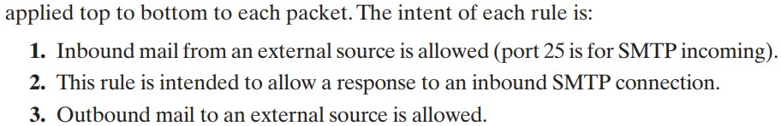
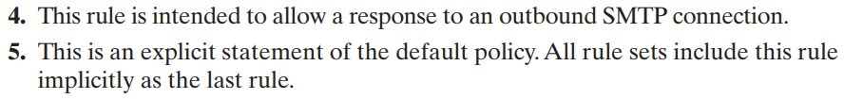
Table 9.1 Packet-Filtering Examples

Slide 11
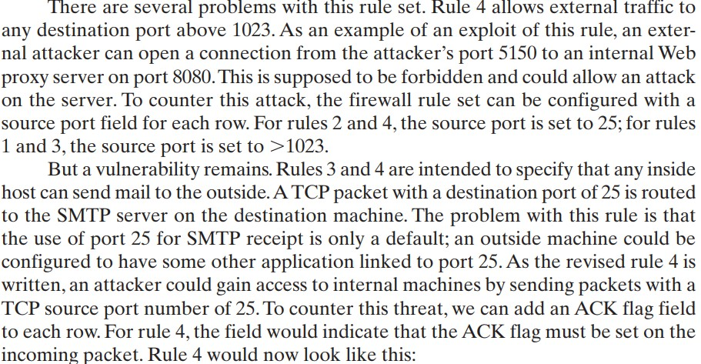
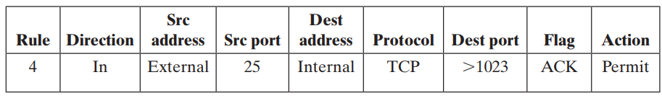

Slide 12
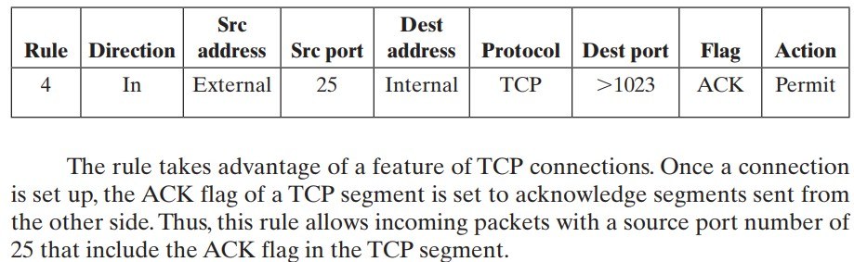
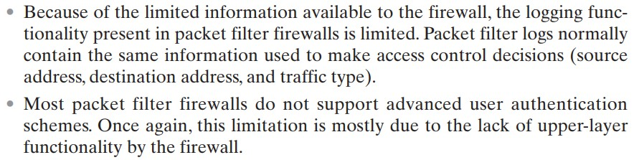

Slide 13
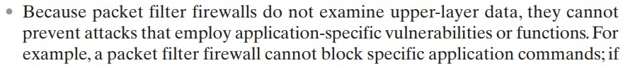

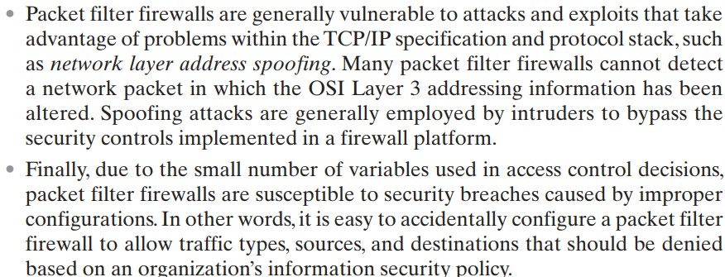

Slide 14
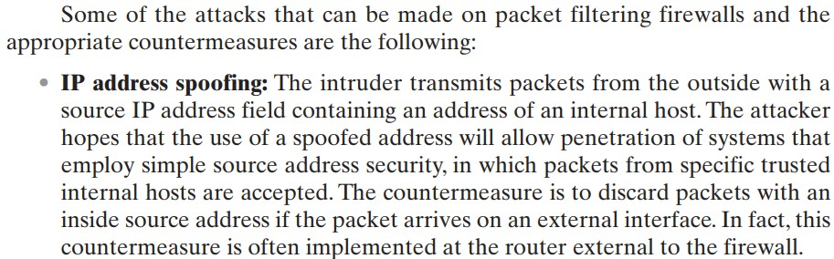
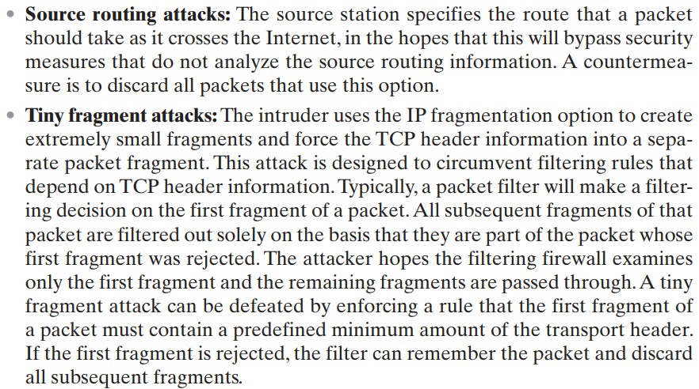

Slide 15
Packet Filter Advantages And Weaknesses
Advantages
Simplicity
Typically transparent to users and are very fast
Weaknesses
Cannot prevent attacks that employ application specific vulnerabilities or functions
Limited logging functionality
Do not support advanced user authentication
Vulnerable to attacks on TCP/IP protocol bugs
Improper configuration can lead to breaches
Notes:
One advantage of a packet filtering firewall is its simplicity. Also, packet filters
typically are transparent to users and are very fast. NIST SP 800-41 lists the following
weaknesses of packet filter firewalls:
• Because packet filter firewalls do not examine upper-layer data, they cannot
prevent attacks that employ application-specific vulnerabilities or functions.
For example, a packet filter firewall cannot block specific application
commands; if a packet filter firewall allows a given application, all functions
available within that application will be permitted.
• Because of the limited information available to the firewall, the logging
functionality present in packet filter firewalls is limited. Packet filter logs
normally contain the same information used to make access control decisions
(source address, destination address, and traffic type).
• Most packet filter firewalls do not support advanced user authentication
schemes. Once again, this limitation is mostly due to the lack of upper-layer
functionality by the firewall.
• Packet filter firewalls are generally vulnerable to attacks and exploits that take
advantage of problems within the TCP/IP specification and protocol stack,
such as network layer address spoofing . Many packet filter firewalls cannot
detect a network packet in which the OSI Layer 3 addressing information has
been altered. Spoofing attacks are generally employed by intruders to bypass
the security controls implemented in a firewall platform.
• Finally, due to the small number of variables used in access control decisions,
packet filter firewalls are susceptible to security breaches caused by improper
configurations. In other words, it is easy to accidentally configure a packet
filter firewall to allow traffic types, sources, and destinations that should be
denied based on an organization’s information security policy.
Some of the attacks that can be made on packet filtering firewalls and the
appropriate countermeasures are the following:
• IP address spoofing : The intruder transmits packets from the outside with a
source IP address field containing an address of an internal host. The attacker
hopes that the use of a spoofed address will allow penetration of systems that
employ simple source address security, in which packets from specific trusted
internal hosts are accepted. The countermeasure is to discard packets with an
inside source address if the packet arrives on an external interface. In fact, this
countermeasure is often implemented at the router external to the firewall.
• Source routing attacks: The source station specifies the route that a packet
should take as it crosses the Internet, in the hopes that this will bypass security
measures that do not analyze the source routing information. A countermeasure
is to discard all packets that use this option.
• Tiny fragment attacks: The intruder uses the IP fragmentation option to create
extremely small fragments and force the TCP header information into
a separate packet fragment. This attack is designed to circumvent filtering
rules that depend on TCP header information. Typically, a packet filter
will make a filtering decision on the first fragment of a packet. All subsequent
fragments of that packet are filtered out solely on the basis that
they are part of the packet whose first fragment was rejected. The attacker
hopes that the filtering firewall examines only the first fragment and that
the remaining fragments are passed through. A tiny fragment attack can be
defeated by enforcing a rule that the first fragment of a packet must contain
a predefined minimum amount of the transport header. If the first fragment
is rejected, the filter can remember the packet and discard all subsequent
fragments.

Slide 16
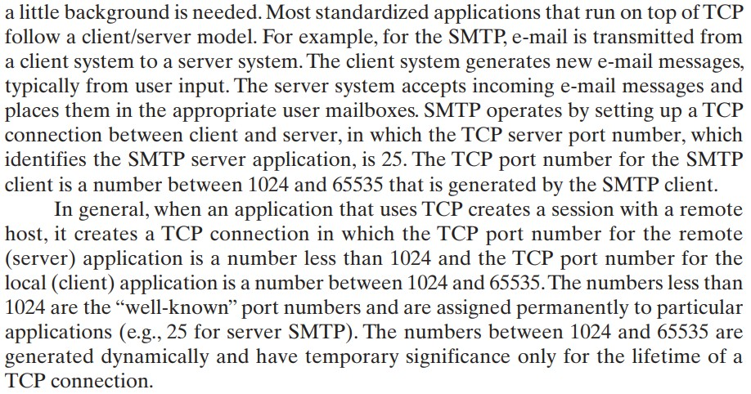

Slide 17

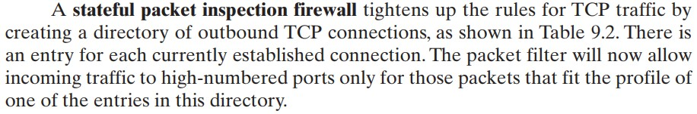
Why we need Stateful Inspection Firewall?

Slide 18
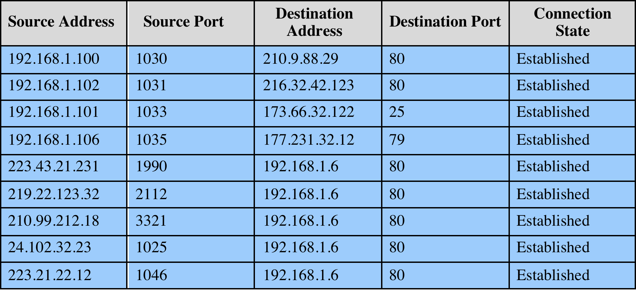
Table 9.2
Example Stateful Firewall
Connection State Table
Notes:
A stateful inspection packet firewall tightens up the rules for TCP traffic by
creating a directory of outbound TCP connections, as shown in Table 9.2 . There is
an entry for each currently established connection. The packet filter will now allow
incoming traffic to high-numbered ports only for those packets that fit the profile of
one of the entries in this directory.
A stateful packet inspection firewall reviews the same packet information
as a packet filtering firewall, but also records information about TCP connections
(Figure 9.1c). Some stateful firewalls also keep track of TCP sequence numbers
to prevent attacks that depend on the sequence number, such as session hijacking.
Some even inspect limited amounts of application data for some well-known
protocols like FTP, IM, and SIPS commands, in order to identify and track related
connections.

Slide 19
Stateful Inspection Firewall
Tightens rules for TCP traffic by creating a directory of outbound TCP connections
There is an entry for each currently established connection
Packet filter allows incoming traffic to high numbered ports only for those packets that fit the profile of one of the entries in this directory
Reviews packet information but also records information about TCP connections
Keeps track of TCP sequence numbers to prevent attacks that depend on the sequence number
Inspects data for protocols like FTP, IM and SIPS commands
Notes:
A traditional packet filter makes filtering decisions on an individual packet basis
and does not take into consideration any higher-layer context. To understand what
is meant by context and why a traditional packet filter is limited with regard to context,
a little background is needed. Most standardized applications that run on top
of TCP follow a client/server model. For example, for the Simple Mail Transfer
Protocol (SMTP), e-mail is transmitted from a client system to a server system.
The client system generates new e-mail messages, typically from user input. The
server system accepts incoming e-mail messages and places them in the appropriate
user mailboxes. SMTP operates by setting up a TCP connection between client
and server, in which the TCP server port number, which identifies the SMTP server
application, is 25. The TCP port number for the SMTP client is a number between
1024 and 65535 that is generated by the SMTP client.
In general, when an application that uses TCP creates a session with a remote
host, it creates a TCP connection in which the TCP port number for the remote
(server) application is a number less than 1024 and the TCP port number for the
local (client) application is a number between 1024 and 65535. The numbers less
than 1024 are the “well-known” port numbers and are assigned permanently to
particular applications (e.g., 25 for server SMTP). The numbers between 1024 and
65535 are generated dynamically and have temporary significance only for the
lifetime of a TCP connection.
A simple packet filtering firewall must permit inbound network traffic on all
these high-numbered ports for TCP-based traffic to occur. This creates a vulnerability
that can be exploited by unauthorized users.

Slide 20
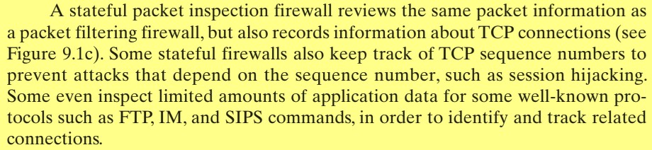
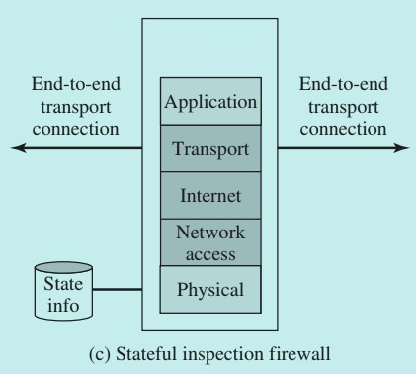
Stateful Inspection Firewall

Slide 21
Application-Level Gateway
Also called an application proxy
Acts as a relay of application-level traffic
User contacts gateway using a TCP/IP application
User is authenticated
Gateway contacts application on remote host and relays TCP segments between server and user
Must have proxy code for each application
May restrict application features supported
Tend to be more secure than packet filters
Disadvantage is the additional processing overhead on each connection
Notes:
An application-level gateway, also called an application proxy , acts as a relay of
application-level traffic ( Figure 9.1d ). The user contacts the gateway using a TCP/
IP application, such as Telnet or FTP, and the gateway asks the user for the name
of the remote host to be accessed. When the user responds and provides a valid
user ID and authentication information, the gateway contacts the application on
the remote host and relays TCP segments containing the application data between
the two endpoints. If the gateway does not implement the proxy code for a specific
application, the service is not supported and cannot be forwarded across the firewall.
Further, the gateway can be configured to support only specific features of an
application that the network administrator considers acceptable while denying all
other features.
Application-level gateways tend to be more secure than packet filters. Rather
than trying to deal with the numerous possible combinations that are to be allowed
and forbidden at the TCP and IP level, the application-level gateway need only
scrutinize a few allowable applications. In addition, it is easy to log and audit all
incoming traffic at the application level.
A prime disadvantage of this type of gateway is the additional processing
overhead on each connection. In effect, there are two spliced connections between
the end users, with the gateway at the splice point, and the gateway must examine
and forward all traffic in both directions.

Slide 22
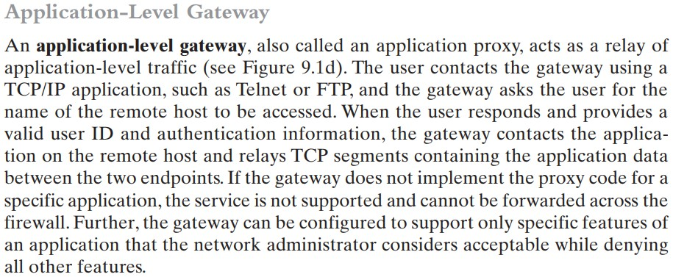
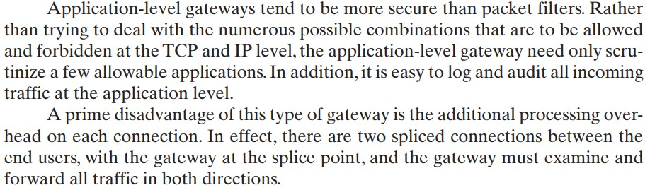

Slide 23
Circuit-Level Gateway
Circuit level proxy
Sets up two TCP connections, one between itself and a TCP user on an inner host and one on an outside host
Relays TCP segments from one connection to the other without examining contents
Security function consists of determining which connections will be allowed
Typically used when inside users are trusted
May use application-level gateway inbound and circuit-level gateway outbound
Lower overheads
Notes:
A fourth type of firewall is the circuit-level gateway or circuit-level proxy ( Figure 9.1e ).
This can be a stand-alone system or it can be a specialized function performed by an
application-level gateway for certain applications. As with an application gateway,
a circuit-level gateway does not permit an end-to-end TCP connection; rather,
the gateway sets up two TCP connections, one between itself and a TCP user on
an inner host and one between itself and a TCP user on an outside host. Once the
two connections are established, the gateway typically relays TCP segments from
one connection to the other without examining the contents. The security function
consists of determining which connections will be allowed.
A typical use of circuit-level gateways is a situation in which the system
administrator trusts the internal users. The gateway can be configured to support
application-level or proxy service on inbound connections and circuit-level functions
for outbound connections. In this configuration, the gateway can incur the processing
overhead of examining incoming application data for forbidden functions but
does not incur that overhead on outgoing data.

Slide 24
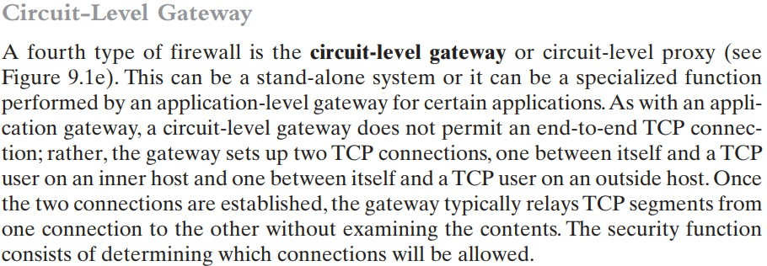
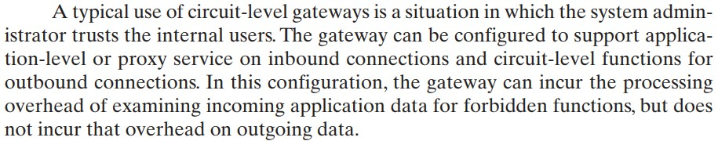

Slide 25
SOCKS Circuit-Level Gateway
SOCKS v5 defined in RFC1928
Designed to provide a framework for client-server applications in TCP/UDP domains to conveniently and securely use the services of a network firewall
Client application contacts SOCKS server, authenticates, sends relay request
Server evaluates and either establishes or denies the connection
SOCKS server
SOCKS client library
SOCKS-ified client applications
Components
Notes:
An example of a circuit-level gateway implementation is the SOCKS package
[KOBL92]; version 5 of SOCKS is specified in RFC 1928. The RFC defines SOCKS
in the following fashion:
The protocol described here is designed to provide a framework for client-server
applications in both the TCP and UDP domains to conveniently and
securely use the services of a network firewall. The protocol is conceptually
a “shim-layer” between the application layer and the transport layer, and as
such does not provide network-layer gateway services, such as forwarding of
ICMP messages.
SOCKS consists of the following components:
• The SOCKS server, which often runs on a UNIX-based firewall. SOCKS is
also implemented on Windows systems.
• The SOCKS client library, which runs on internal hosts protected by the firewall.
• SOCKS-ified versions of several standard client programs such as FTP and
TELNET. The implementation of the SOCKS protocol typically involves
either the recompilation or relinking of TCP-based client applications, or the
use of alternate dynamically loaded libraries, to use the appropriate encapsulation
routines in the SOCKS library.
When a TCP-based client wishes to establish a connection to an object that is
reachable only via a firewall (such determination is left up to the implementation),
it must open a TCP connection to the appropriate SOCKS port on the SOCKS
server system. The SOCKS service is located on TCP port 1080. If the connection
request succeeds, the client enters a negotiation for the authentication method to
be used, authenticates with the chosen method, and then sends a relay request. The
SOCKS server evaluates the request and either establishes the appropriate connection
or denies it. UDP exchanges are handled in a similar fashion. In essence, a TCP
connection is opened to authenticate a user to send and receive UDP segments, and
the UDP segments are forwarded as long as the TCP connection is open.

Slide 26
Intrusion Prevention Systems (IPS)
Also known as Intrusion Detection and Prevention System (IDPS)
Is an extension of an IDS that includes the capability to attempt to block or prevent detected malicious activity
Can be host-based, network-based, or distributed/hybrid
Can use anomaly detection to identify behavior that is not that of legitimate users, or signature/heuristic detection to identify known malicious behavior can block traffic as a firewall does, but makes use of the types of algorithms developed for IDSs to determine when to do so
Notes:
A further addition to the range of security products is the intrusion prevention system
(IPS), also known as intrusion detection and prevention system (IDPS). It is
an extension of an IDS that includes the capability to attempt to block or prevent
detected malicious activity. Like an IDS, an IPS can be host-based, network-based,
or distributed/hybrid, as we discuss in Chapter 8. Similarly, it can use anomaly
detection to identify behavior that is not that of legitimate users, or signature/heuristic
detection to identify known malicious behavior.
Once an IDS has detected malicious activity, it can respond by modifying
or blocking network packets across a perimeter or into a host, or by modifying or
blocking system calls by programs running on a host. Thus, a network IPS can block
traffic, as a firewall does, but makes use of the types of algorithms developed for
IDSs to determine when to do so. It is a matter of terminology whether a network
IPS is considered a separate, new type of product or simply another form of firewall.

Slide 27
Host-Based IPS (HIPS)
Can make use of either signature/heuristic or anomaly detection techniques to identify attacks
Signature: focus is on the specific content of application network traffic, or of sequences of system calls, looking for patterns that have been identified as malicious
Anomaly: IPS is looking for behavior patterns that indicate malware
Examples of the types of malicious behavior addressed by a HIPS include:
Modification of system resources
Privilege-escalation exploits
Buffer-overflow exploits
Access to e-mail contact list
Directory traversal
Notes:
A host-based IPS (HIPS) can make use of either signature/heuristic or anomaly
detection techniques to identify attacks. In the former case, the focus is on the specific
content of application network traffic, or of sequences of system calls, looking
for patterns that have been identified as malicious. In the case of anomaly detection,
the IPS is looking for behavior patterns that indicate malware. Examples of the
types of malicious behavior addressed by a HIPS include the following:
• Modification of system resources: Rootkits, Trojan horses, and backdoors
operate by changing system resources, such as libraries, directories, registry
settings, and user accounts.
• Privilege-escalation exploits: These attacks attempt to give ordinary users
root access.
• Buffer-overflow exploits: These attacks are described in Chapter 10 .
• Access to e-mail contact list: Many worms spread by mailing a copy of themselves
to addresses in the local system’s e-mail address book.
• Directory traversal: A directory traversal vulnerability in a Web server allows
the hacker to access files outside the range of what a server application user
would normally need to access.

Slide 28
Host-Based IPS (HIPS)
Examples of the types of malicious behavior addressed by a HIPS include the following:
Modification of system resources: Rootkits, Trojan horses, and backdoors operate by changing system resources, such as libraries, directories, registry settings, and user accounts.
Privilege-escalation exploits: These attacks attempt to give ordinary users root access.
Buffer-overflow exploits: Attackers exploit buffer overflow issues by overwriting the memory of an application
Access to e-mail contact list: Many worms spread by mailing a copy of themselves to addresses in the local system’s e-mail address book.
Directory traversal: A directory traversal vulnerability in a Web server allows the hacker to access files outside
Notes:
A host-based IPS (HIPS) can make use of either signature/heuristic or anomaly
detection techniques to identify attacks. In the former case, the focus is on the specific
content of application network traffic, or of sequences of system calls, looking
for patterns that have been identified as malicious. In the case of anomaly detection,
the IPS is looking for behavior patterns that indicate malware. Examples of the
types of malicious behavior addressed by a HIPS include the following:
• Modification of system resources: Rootkits, Trojan horses, and backdoors
operate by changing system resources, such as libraries, directories, registry
settings, and user accounts.
• Privilege-escalation exploits: These attacks attempt to give ordinary users
root access.
• Buffer-overflow exploits: These attacks are described in Chapter 10 .
• Access to e-mail contact list: Many worms spread by mailing a copy of themselves
to addresses in the local system’s e-mail address book.
• Directory traversal: A directory traversal vulnerability in a Web server allows
the hacker to access files outside the range of what a server application user
would normally need to access.

Slide 29
HIPS
Capability can be tailored to the specific platform
A set of general purpose tools may be used for a desktop or server system
Some packages are designed to protect specific types of servers, such as Web servers and database servers
In this case the HIPS looks for particular application attacks
Can use a sandbox approach
Sandboxes are especially suited to mobile code such as Java applets and scripting languages
HIPS quarantines such code in an isolated system area then runs the code and monitors its behavior
Areas for which a HIPS typically offers desktop protection:
System calls
File system access
System registry settings
Host input/output
Notes:
Attacks such as these result in behaviors that can be analyzed by a HIPS. The
HIPS capability can be tailored to the specific platform. A set of general-purpose
tools may be used for a desktop or server system. Some HIPS packages are designed
to protect specific types of servers, such as Web servers and database servers. In this
case, the HIPS looks for particular application attacks.
In addition to signature and anomaly-detection techniques, a HIPS can use
a sandbox approach. Sandboxes are especially suited to mobile code, such as Java
applets and scripting languages. The HIPS quarantines such code in an isolated
system area, then runs the code and monitors its behavior. If the code violates
predefined policies or matches predefined behavior signatures, it is halted and
prevented from executing in the normal system environment.
[ROBB06a] lists the following as areas for which a HIPS typically offers desktop
protection:
• System calls: The kernel controls access to system resources such as memory,
I/O devices, and processor. To use these resources, user applications invoke
system calls to the kernel. Any exploit code will execute at least one system
call. The HIPS can be configured to examine each system call for malicious
characteristics.
• File system access: The HIPS can ensure that file access system calls are not
malicious and meet established policy.
System registry settings: The registry maintains persistent configuration
information about programs and is often maliciously modified to extend the
life of an exploit. The HIPS can ensure that the system registry maintains its
integrity.
• Host input/output: I/O communications, whether local or network based, can
propagate exploit code and malware. The HIPS can examine and enforce
proper client interaction with the network and its interaction with other
devices.

Slide 30
Host-Based IPS (HIPS)
[ROBB06a] lists the following as areas for which a HIPS typically offers desktop protection:
System calls: The kernel controls access to system resources such as memory, I/O devices, and processor. To use these resources, user applications invoke system calls to the kernel. Any exploit code will execute at least one system call. The HIPS can be configured to examine each system call for malicious characteristics.
File system access: The HIPS can ensure that file access system calls are not malicious and meet established policy.
System registry settings: The registry maintains persistent configuration information about programs and is often maliciously modified to extend the life of an exploit. The HIPS can ensure that the system registry maintains its integrity.
Host input/output: I/O communications, whether local or network-based, can propagate exploit code and malware. The HIPS can examine and enforce proper client interaction with the network and its interaction with other devices.

Slide 31
The Role of HIPS
Many industry observers see the enterprise endpoint, including desktop and laptop systems, as now the main target for hackers and criminals
Thus security vendors are focusing more on developing endpoint security products
Traditionally, endpoint security has been provided by a collection of distinct products, such as antivirus, antispyware, antispam, and personal firewalls
Approach is an effort to provide an integrated, single-product suite of functions
Advantages of the integrated HIPS approach are that the various tools work closely together, threat prevention is more comprehensive, and management is easier
A prudent approach is to use HIPS as one element in a defense-in-depth strategy that involves network-level devices, such as either firewalls or network-based IPSs
Notes:
Many industry observers see the enterprise endpoint,
including desktop and laptop systems, as now the main target for hackers and
criminals, more so than network devices [ROBB06b]. Thus, security vendors are
focusing more on developing endpoint security products. Traditionally, endpoint
security has been provided by a collection of distinct products, such as antivirus,
antispyware, antispam, and personal firewalls. The HIPS approach is an effort to
provide an integrated, single-product suite of functions. The advantages of the
integrated HIPS approach are that the various tools work closely together, threat
prevention is more comprehensive, and management is easier.
It may be tempting to think that endpoint security products such as HIPS,
if sophisticated enough, eliminate or at least reduce the need for network-level
devices. For example, the San Diego Supercomputer Center reports that over a
four-year period, there were no intrusions on any of its managed machines, in a
configuration with no firewalls and just endpoint security protection [SING03].
Nevertheless, a more prudent approach is to use HIPS as one element in a strategy
that involves network-level devices, such as either firewalls or network-based
IPSs.

Slide 32
Network-Based IPS (NIPS)
Inline NIDS with the authority to modify or discard packets and tear down TCP connections
Makes use of signature/heuristic detection and anomaly detection
May provide flow data protection
Requires that the application payload in a sequence of packets be reassembled
Methods used to identify malicious packets:
Pattern matching
Stateful matching
Protocol anomaly
Traffic anomaly
Statistical anomaly
Notes:
A network-based IPS (NIPS) is in essence an inline NIDS with the authority to
discard packets and tear down TCP connections. As with a NIDS, a NIPS makes use
of techniques such as signature detection and anomaly detection.
Among the techniques used in a NIPS but not commonly found in a firewall
is flow data protection. This requires that the application payload in a sequence
of packets be reassembled. The IPS device applies filters to the full content of the
flow every time a new packet for the flow arrives. When a flow is determined to be
malicious, the latest and all subsequent packets belonging to the suspect flow are
dropped.
In terms of the general methods used by a NIPS device to identify malicious
packets, the following are typical:
• Pattern matching: Scans incoming packets for specific byte sequences (the
signature) stored in a database of known attacks
• Stateful matching: Scans for attack signatures in the context of a traffic stream
rather than individual packets
• Protocol anomaly: Looks for deviation from standards set forth in RFCs
Traffic anomaly: Watches for unusual traffic activities, such as a flood of UDP
packets or a new service appearing on the network
• Statistical anomaly: Develops baselines of normal traffic activity and throughput,
and alerts on deviations from those baselines

Slide 33
Network-Based IPS (NIPS)
In terms of the general methods used by a NIPS device to identify malicious packets, the following are typical:
Pattern matching: Scans incoming packets for specific byte sequences (the signature) stored in a database of known attacks
Stateful matching: Scans for attack signatures in the context of a traffic stream rather than individual packets
Protocol anomaly: Looks for deviation from standards set forth in RFCs
Traffic anomaly: Watches for unusual traffic activities, such as a flood of UDP packets or a new service appearing on the network
Statistical anomaly: Develops baselines of normal traffic activity and throughput, and alerts on deviations from those baselines

Slide 34
Distributed or Hybrid IPS
The final category of IPS is in a distributed or hybrid approach.
This gathers data from a large number of host and network-based sensors, relays this intelligence to a central analysis system able to correlate, and analyze the data, which can then return updated signatures and behavior patterns to enable all of the coordinated systems to respond and defend against malicious behavior.
A number of such systems have been proposed. One of the best known is the digital immune system.

Slide 35
Digital Immune System
Comprehensive defense against malicious behavior caused by malware
Developed by IBM and refined by Symantec
Motivation for this development includes the rising threat of Internet-based malware, the increasing speed of its propagation provided by the Internet, and the need to acquire a global view of the situation
Success depends on the ability of the malware analysis system to detect new and innovative malware strains
Notes:
The final category of IPS is in a distributed or hybrid approach. This gathers data
from a large number of host and network-based sensors, relays this intelligence to
a central analysis system able to correlate, and analyze the data, which can then
return updated signatures and behavior patterns to enable all of the coordinated
systems to respond and defend against malicious behavior. A number of such systems
have been proposed. One of the best known is the digital immune system.
The digital immune system is a comprehensive defense
against malicious behavior caused by malware, developed by IBM [KEPH97a,
KEPH97b, WHIT99], and subsequently refined by Symantec [SYMA01] and
incorporated into its Central Quarantine produce [SYMA05]. The
motivation for this development includes the rising threat of Internet-based
malware, the increasing speed of its propagation provided by the Internet, and the
need to acquire a global view of the situation.
In response to the threat posed by these Internet-based capabilities, IBM
developed the original prototype digital immune system. This system expands on
the use of program emulation discussed in Section 6.10 and provides a general-purpose
emulation and malware detection system. The objective of this system is to
provide rapid response time so that malware can be stamped out almost as soon as
they are introduced. When new malware enters an organization, the immune system
automatically captures it, analyzes it, adds detection and shielding for it, removes it,
and passes information about it to client systems, so the malware can be detected
before it is allowed to run elsewhere.
The success of the digital immune system depends on the ability of the malware
analysis system to detect new and innovative malware strains. By constantly
analyzing and monitoring malware found in the wild, it should be possible to continually
update the digital immune software to keep up with the threat.

Slide 36
Figure 9.5 Placement of Malware Monitors (adapted from [SIDI05])
Notes:
Figure 9.5 shows an example of a hybrid architecture designed originally to
detect worms [SIDI05]. The system works as follows (numbers in figure refer to
numbers in the following list):
1. Sensors deployed at various network and host locations detect potential malware
scanning, infection or execution. The sensor logic can also be incorporated
in IDS sensors.
2. The sensors send alerts and copies of detected malware to a central server,
which correlates and analyzes this information. The correlation server determines
the likelihood that malware is being observed and its key characteristics.
3. The server forwards its information to a protected environment, where the
potential malware may be sandboxed for analysis and testing.
4. The protected system tests the suspicious software against an appropriately
instrumented version of the targeted application to identify the vulnerability.
5. The protected system generates one or more software patches and tests these.
6. If the patch is not susceptible to the infection and does not compromise the
application’s functionality, the system sends the patch to the application host
to update the targeted application.

Slide 37
Figure 9.5 shows an example of a hybrid architecture designed originally to detect worms [SIDI05]. The system works as follows (numbers in figure refer to numbers in the following list):
Sensors deployed at various network and host locations detect potential malware scanning, infection or execution. The sensor logic can also be incorporated in IDS sensors.
The sensors send alerts and copies of detected malware to a central server, which correlates and analyzes this information. The correlation server determines the likelihood that malware is being observed and its key characteristics.
The server forwards its information to a protected environment, where the potential malware may be sandboxed for analysis and testing.
The protected system tests the suspicious software against an appropriately instrumented version of the targeted application to identify the vulnerability.
The protected system generates one or more software patches and tests these.
If the patch is not susceptible to the infection and does not compromise the application’s functionality, the system sends the patch to the application host to update the targeted application.

Slide 38
Snort Inline
Drop
Snort rejects a packet based on the options defined in the rule and logs the result
Reject
Packet is rejected and result is logged and an error message is returned
Sdrop
Packet is rejected but not logged
Enables Snort to function as an intrusion prevention system
Includes a replace option which allows the Snort user to modify packets rather than drop them
Useful for a honeypot implementation
Attackers see the failure but cannot figure out why it occurred
Notes:
We introduced Snort in Section 8.9 as a lightweight intrusion detection system.
A modified version of Snort, known as Snort Inline [KURU12],
enhances Snort to function as an intrusion prevention system. Snort Inline adds three new rule types that
provide intrusion prevention features:
• Drop: Snort rejects a packet based on the options defined in the rule and logs
the result.
• Reject: Snort rejects a packet and logs the result. In addition, an error message
is returned. In the case of TCP, this is a TCP reset message, which resets the
TCP connection. In the case of UDP, an ICMP port unreachable message is
sent to the originator of the UDP packet.
• Sdrop: Snort rejects a packet but does not log the packet.
Snort Inline includes a replace option, which allows the Snort user to modify
packets rather than drop them. This feature is useful for a honeypot implementation
[SPIT03]. Instead of blocking detected attacks, the honeypot modifies and
disables them by modifying packet content. Attackers launch their exploits, which
travel the Internet and hit their intended targets, but Snort Inline disables the
attacks, which ultimately fail. The attackers see the failure but can’t figure out why
it occurred. The honeypot can continue to monitor the attackers while reducing the
risk of harming remote systems.

